Slide 1

Project Review Meeting
A
on
LLM-Based Customer Support Chatbot with
Knowledge Retrieval
Submitted by
M.VENNELA R.PRAVALLIKA
2420030218
2420090073
Group: 15 Section : 7
Specialization-
APPLIED MACHINE LEARNING FOR TEXT ANALYSIS
Under guidance of: DR.K.SWANTHANA

Slide 2
Outline of the presentation
Problem Statement
Objectives
Literature Survey
Research Gap Identification
Innovation
Novelty
Creativity
Feasibility
Project Plan

Slide 3
Problem Statement
Traditional chatbots depend on rules and keywords, limiting their ability to handle complex queries.
Large organizational knowledge bases make information retrieval difficult and time-consuming.
Standalone LLMs may generate inaccurate or unsupported responses without organization-specific knowledge.
Existing systems often lack context awareness and source transparency.
Therefore, there is a need for a RAG-based intelligent chatbot that provides accurate, contextual, explainable, and reliable customer support.

Slide 4
Objectives
Develop an intelligent customer-facing chatbot using an LLM for automated customer support.
Implement a RAG system using embeddings and FAISS to retrieve relevant knowledge from support documents.
Generate accurate and context-aware responses using the retrieved information.
Improve reliability and transparency through source attribution and confidence estimation.
Support multi-turn conversations using conversation history and contextual understanding.

Slide 5

Literature Survey
S. No. | Research Paper | Year | Method / Technology | Key Contribution | Relevance to Our Project | Link
1 | Retrieval Enhancements for RAG: Insights from a Deployed Customer Support Chatbot — Daniel González Juclà et al. | 2026 | RAG, embeddings, chunking, RRF, LLM reranking | Studies retrieval improvements in a real deployed customer-support chatbot and shows that better retrieval improves downstream response quality. | Directly supports our embedding, chunking, FAISS retrieval and Top-K document selection. | ACL Anthology
2 | Retrieval-Augmented Generation with Knowledge Graphs for Customer Service Question Answering — Zhentao Xu et al. | 2024 | RAG, LLM, Knowledge Graph, semantic retrieval | Uses structured knowledge from historical customer-service issues to improve retrieval and question answering; reports improved retrieval and generation performance. | Supports our customer-service QA and knowledge retrieval approach and provides a possible future Knowledge Graph extension. | Research Paper –

Slide 6
Literature Survey
S. No. | Research Paper | Year | Method / Technology | Key Contribution | Relevance to Our Project | Link
3 | Supporting Human Operators During Customer Service Interactions with Agentic-RAG — Juan Barrionuevo-Valenzuela et al. | 2026 | Agentic-RAG, retrieval validation, summarization, LLM | Uses RAG to assist human customer-service operators with relevant information, summaries and suggested responses. | Directly supports our proposed human-agent escalation and conversation-context features.
ACL
Anthology

Slide 7
Research Gap Identification
Paper | What the Paper Addresses | Identified Gap / Limitation | How Our Project Addresses the Gap
1. Juclà et al. (2026) — Retrieval Enhancements for RAG: Insights from a Deployed Customer Support Chatbot | Focuses mainly on improving RAG retrieval quality through embedding comparison, chunking, RRF, and LLM-based reranking in a deployed customer-support chatbot. | The study primarily focuses on retrieval optimization. There is scope to integrate retrieval with a broader customer-support system involving conversational context, explainability, confidence estimation, and intelligent escalation. | Our project combines semantic retrieval with LLM response generation, multi-turn conversation, source attribution, confidence estimation.
2. Xu et al. (2024) — Retrieval-Augmented Generation with Knowledge Graphs for Customer Service Question Answering | Uses RAG + Knowledge Graphs to preserve relationships within and between historical customer-service issues and improve retrieval and answer generation. | The approach relies on knowledge-graph construction from historical issue tickets, which adds structural complexity. There is scope for a more lightweight document-based RAG architecture suitable for broader customer-support knowledge such as FAQs, manuals and policies. | Our system uses FAISS to retrieve relevant information from diverse support documents, followed by LLM-based response generation.
3. Barrionuevo-Valenzuela et al. (2026) — Supporting Human Operators During Customer Service Interactions with Agentic-RAG | Develops an Agentic-RAG copilot that assists human operators through summaries, relevant information and suggested responses, using agents for routing, retrieval validation and response generation. | The primary focus is supporting human operators in call centers, rather than providing a complete self-service chatbot with user-facing explainability, confidence information and broader knowledge-base interaction. | Our project focuses on a direct customer-facing chatbot, while retaining human escalation for unresolved or low-confidence queries. It also proposes source attribution, confidence estimation and multi-turn conversation.

Slide 8
Innovation
RAG-Based Knowledge Retrieval: Retrieves relevant information from FAQs, manuals, policies, and support documents before generating responses.
LLM-Powered Responses: Uses an LLM such as Gemini or Llama 3 to generate natural, accurate, and context-aware answers.
Semantic Search: Uses embeddings and FAISS vector search to understand the meaning of customer queries rather than relying only on keywords.
Explainable Responses: Provides source attribution and confidence estimation, helping users understand and trust the generated answers.

Slide 9
Novelty
Unified AI Customer Support: Integrates RAG, LLM, semantic search, and conversational AI into a single platform.
Knowledge-Grounded Answers: Generates responses based on retrieved organizational knowledge, reducing unsupported answers.
Explainable Responses: confidence information with the generated answer.

Slide 10
Creativity
Natural Conversational Interaction: Allows customers to ask questions in their own words instead of following predefined options.
Context-Aware Conversations: Uses previous messages to understand follow-up questions and maintain conversation flow.
Conversation Summarization: Summarizes previous interactions to help maintain context and support efficient human-agent handover.

Slide 11
Feasibility
Technical Feasibility: The system can be developed using existing technologies such as React, FastAPI, embeddings, FAISS, and LLMs such as Gemini or Llama 3.
Data Feasibility: The chatbot can use available FAQs, product manuals, user guides, policies, and customer-support knowledge bases as its knowledge source.
Implementation Feasibility: RAG allows the system to use existing LLMs without requiring the development or training of a large language model from scratch.
Scalability: The knowledge base can be expanded by adding new documents and updating their embeddings.
Evaluation Feasibility: The system can be evaluated using retrieval accuracy, response relevance, answer correctness, semantic similarity, response latency, and user satisfaction.

Slide 12
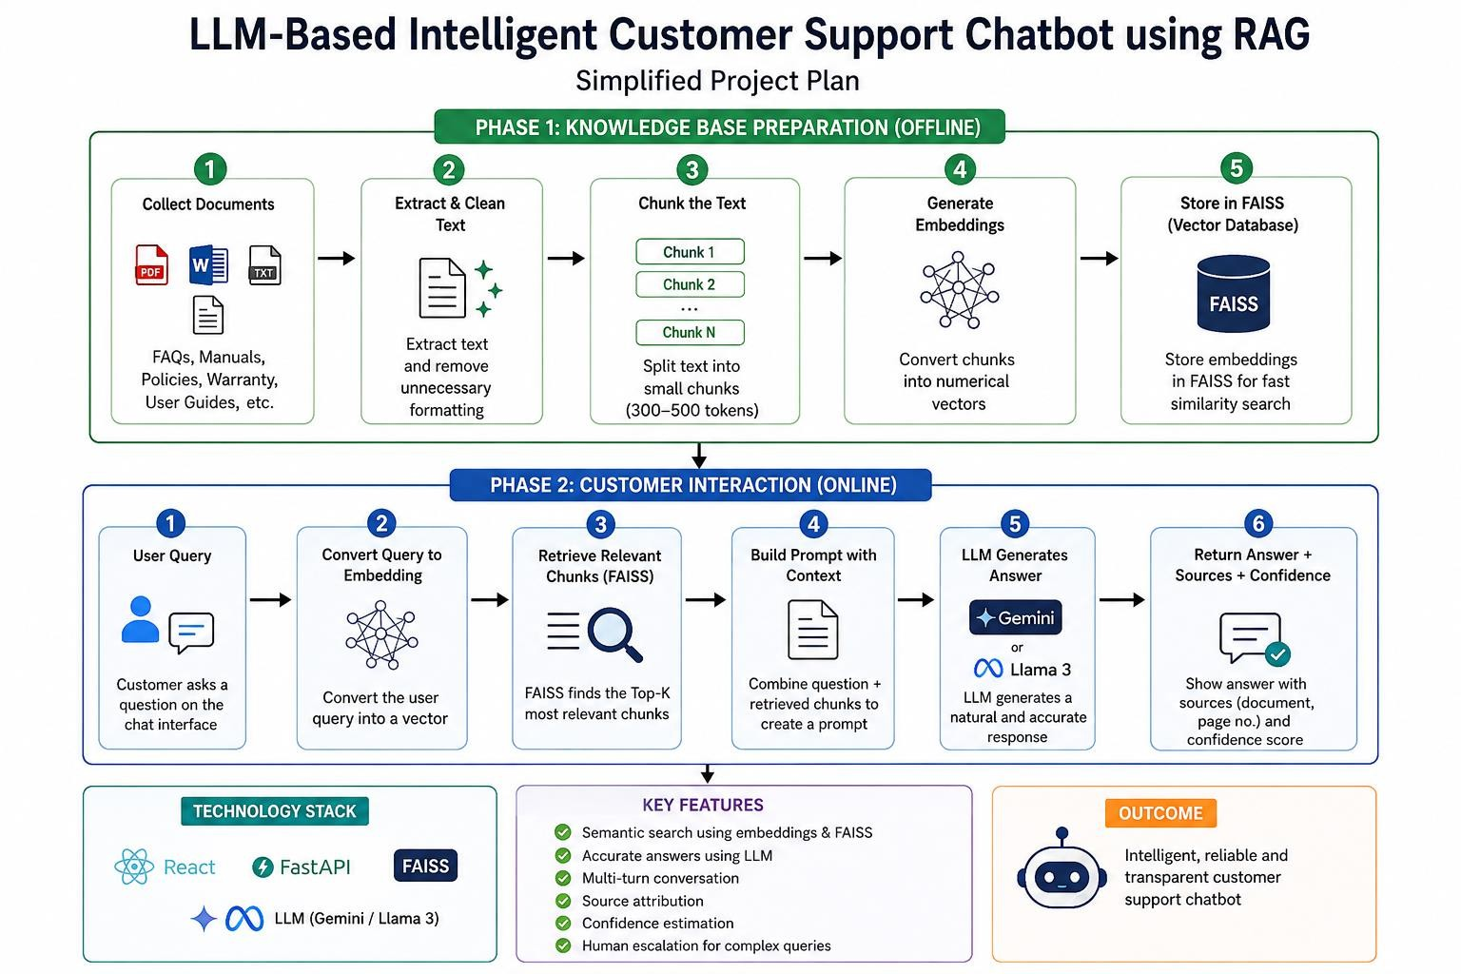
Project Plan

Slide 13
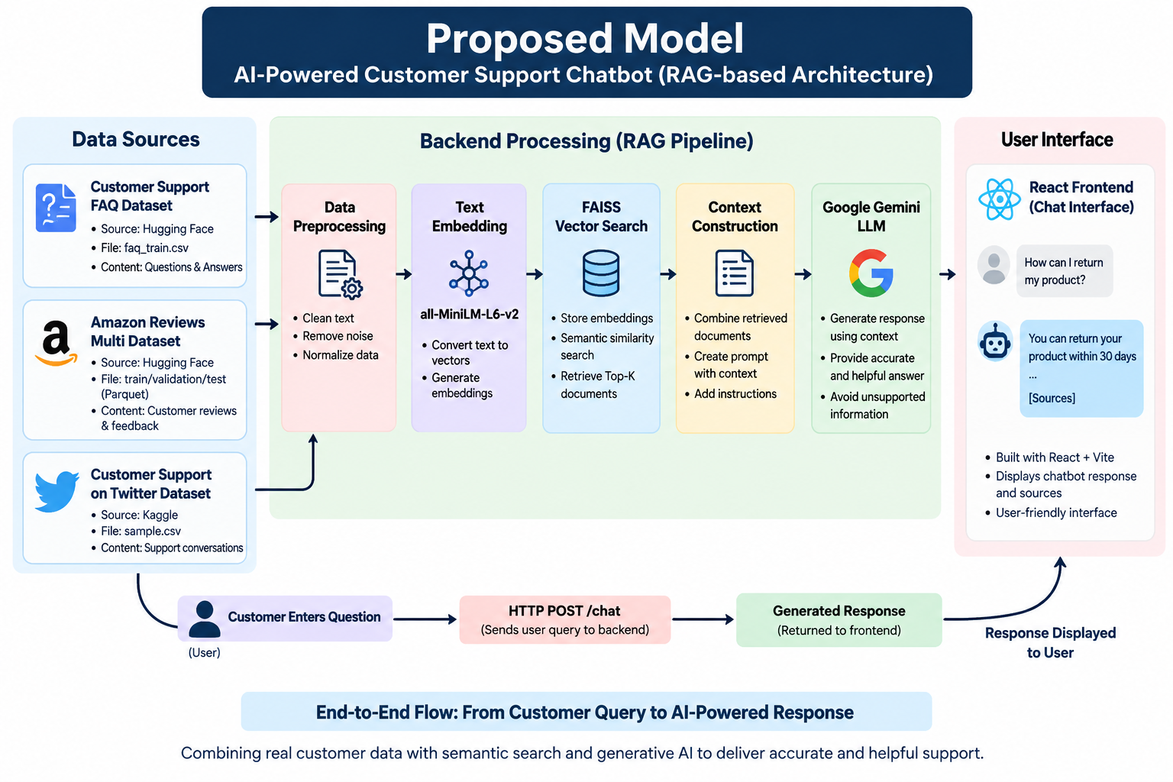
Proposed Model

Slide 14
Project Implementation
1. Data Preparation
Collect customer-support FAQs → preprocess and clean the text → generate Transformer-based embeddings using all-MiniLM-L6-v2 → store them in a FAISS vector index.
2. Product Selection & Query
Customer selects their purchased product and enters a support question.
3. Product-Aware Retrieval
The question is converted into an embedding → relevant product-specific information is filtered and retrieved using FAISS Top-K semantic search.
4. Prompt Construction
The retrieved FAQ information is combined with the customer's question to create a context-aware prompt.
5. Response Generation
The prompt is sent to Gemini LLM, which generates a natural, knowledge-grounded response.
6. User Interaction
The response and relevant sources are returned through the FastAPI backend and displayed in the React chat interface.
Overall Flow
Customer → Product Selection → Query Embedding → Product-Aware FAISS Retrieval → Context + Prompt → Gemini → Grounded Response → React UI

Slide 15
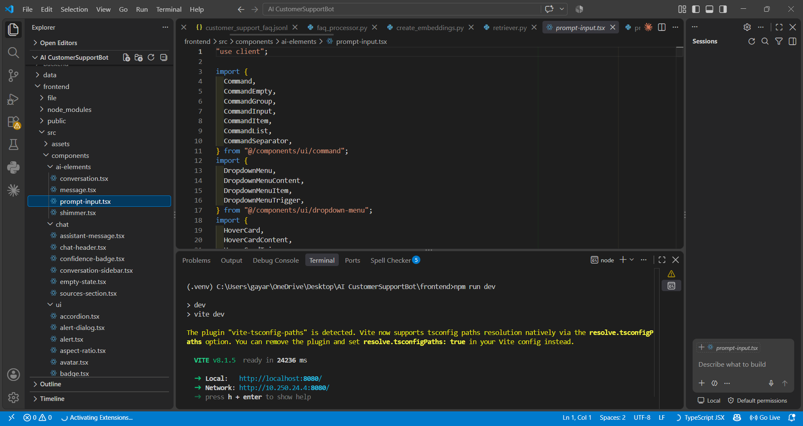
Frontend Code

Slide 16
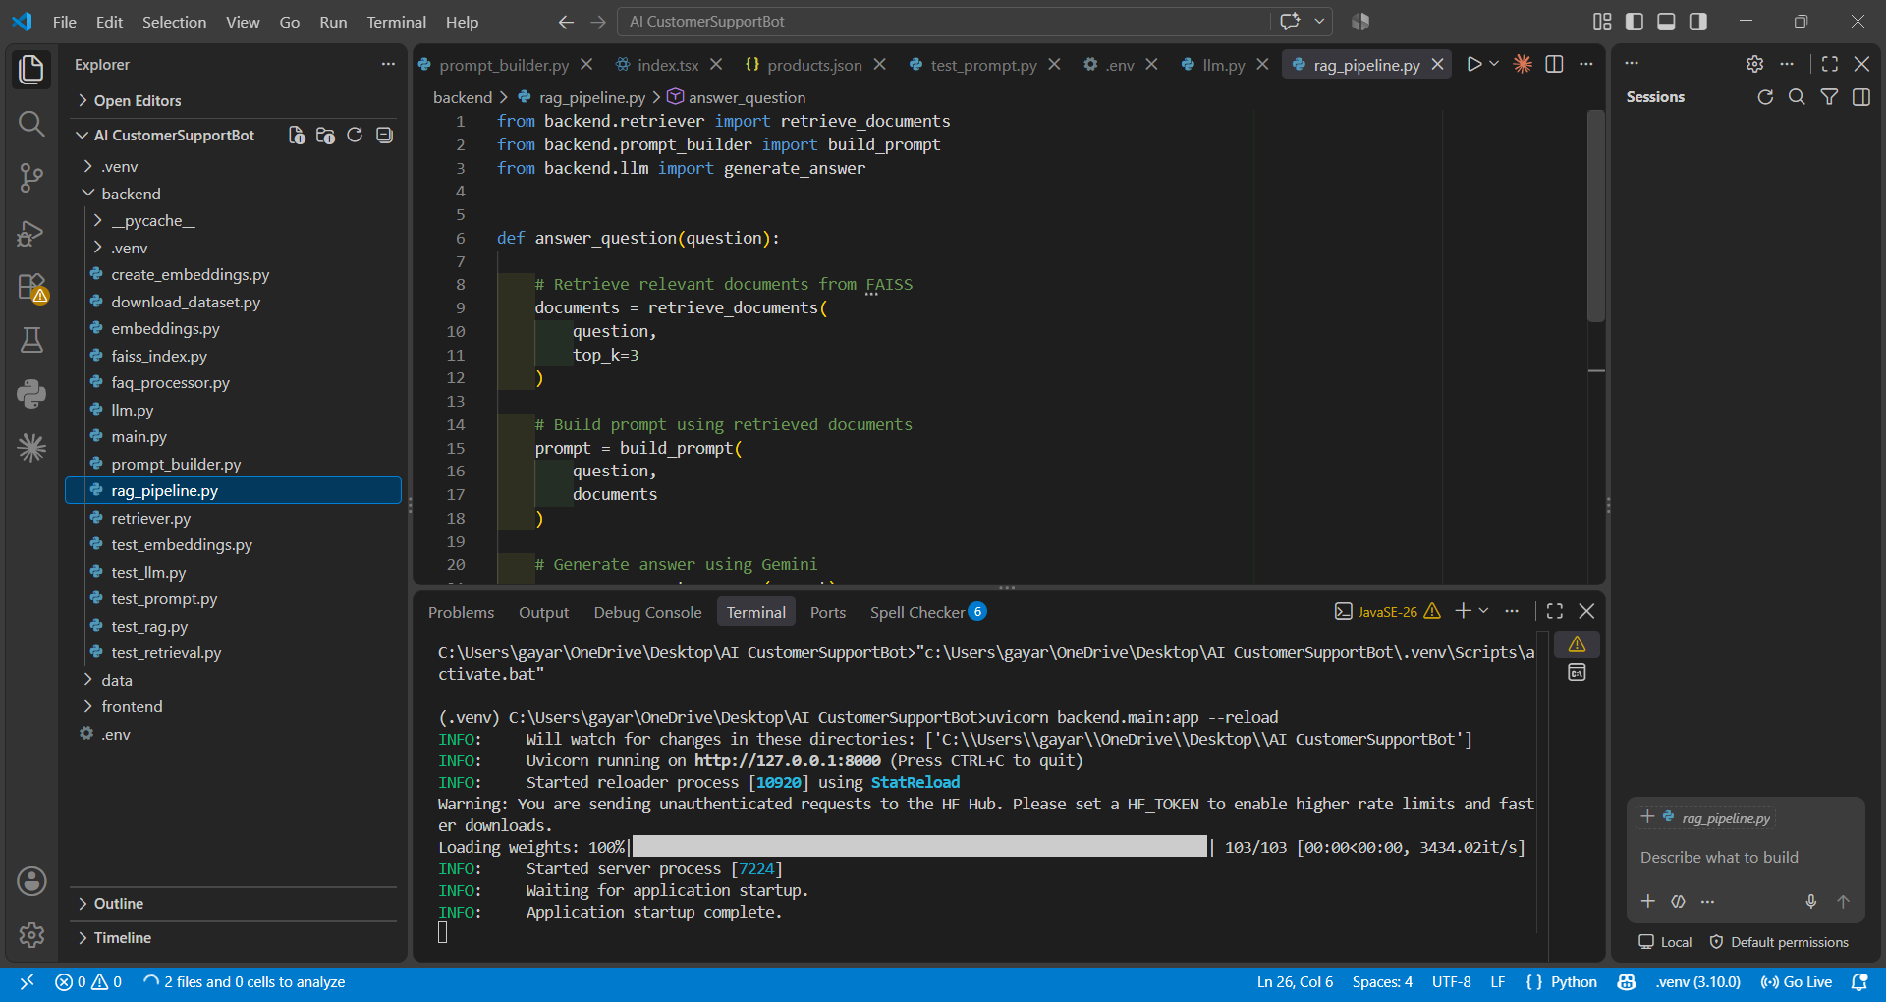
Backend Code

Slide 17
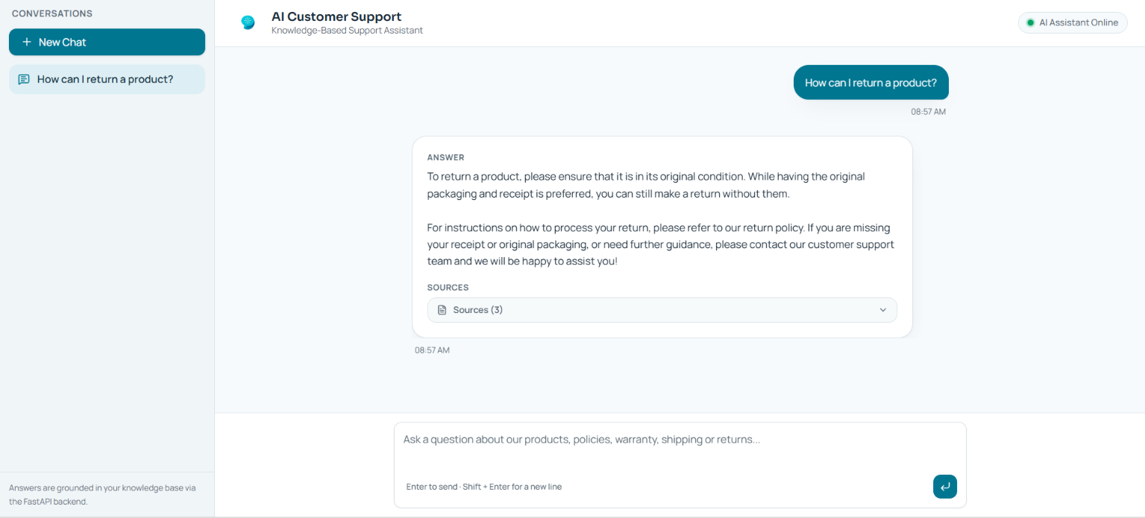
OUTPUT

Slide 18
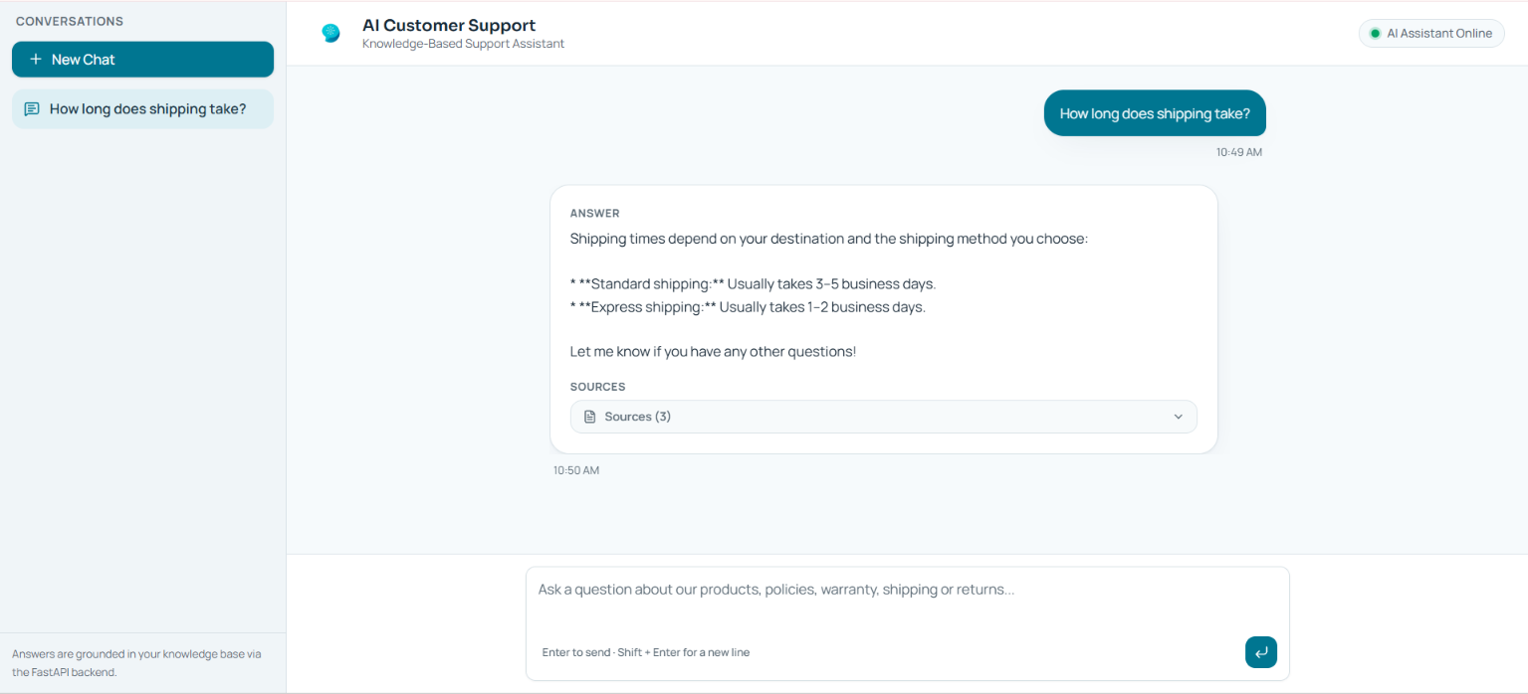
Output

